Slide 1
Automated Plant Watering System Using C8051F340
By:
Radhika Desai (PA34)
Piyush Pamnani (PA35)
Ruchin Shroff (PA36)

Slide 2
Introduction
This project is about a moisture-sensing automatic plant watering system using C8051F340 microcontroller. The system simply senses the moisture level and switches on the irrigation pump when the moisture is below the set limit. The system switches off the pump when the moisture rises above the set point. The status of the pump (whether ON or OFF) is displayed on a 16×2 LCD display. In the domain of farming, utilization of appropriate means of irrigation is significant.

Slide 3
Component Selection
Soil Moisture Sensor
Water level Sensor
C8051F380
Stepper Motor
Variable Resistors
Resistors
LCD Display
Driver L293D

Slide 4
Sensor Specifications
Soil Moisture Sensor: This is an Electrical resistance Sensor. The sensor is made up of two electrodes. This soil moisture sensor reads the moisture content around it. A current is passed across the electrodes through the soil and the resistance to the current in the soil determines the soil moisture.
Water level Sensor: The water pump uses centrifugal force to send fluid to the outside while it spins, causing fluid to be drawn from the centre continuously. The inlet to the pump is located near the centre so that fluid returning from the radiator hits the pump vanes. The pump vanes fling the fluid to the outside of the pump, where it can enter the engine. The fluid leaving the pump flows first through the engine block and cylinder head, then into the radiator and finally back to the pump.

Slide 5
Block Diagram

Slide 6
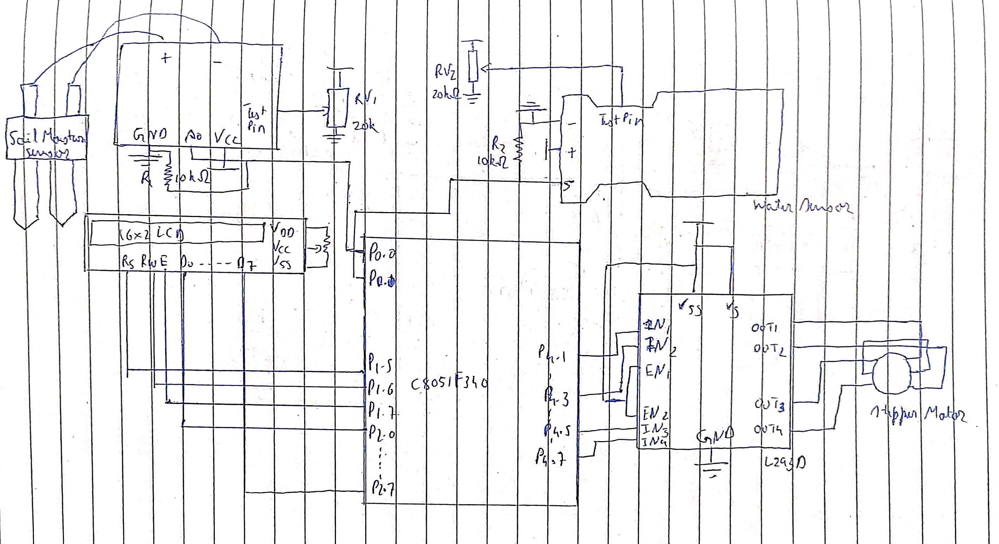
Interfacing Diagram

Slide 7
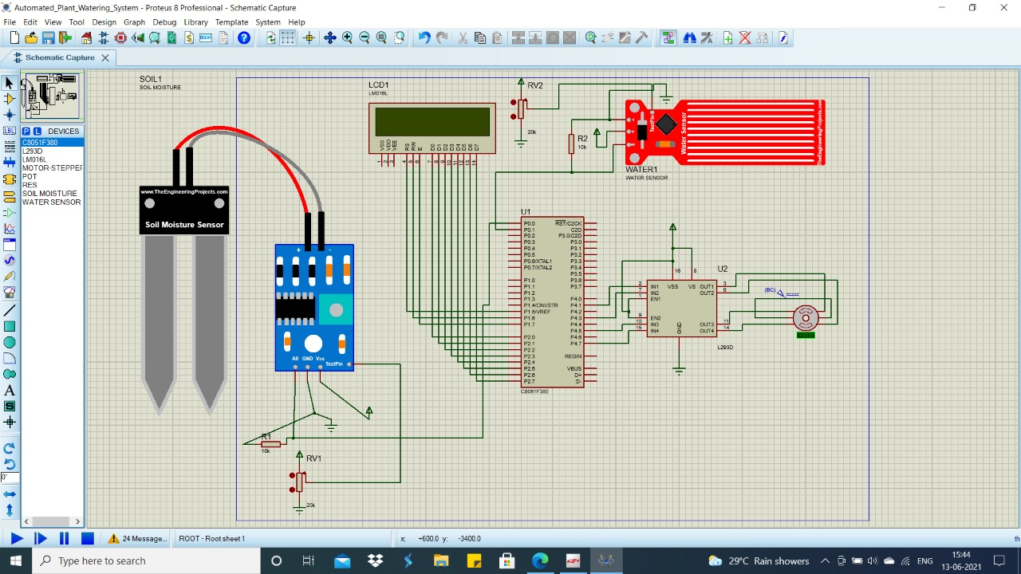
Simulation

Slide 8
Applications
The Automated Plant Watering System can be applied for indoor house plants to regulate the water supply.
Multiple plants can be watered by increasing the number of sensors in the system.
GSM can be used so that the user can be notified whether his plants are required to be watered or not.
IoT can be used to inform the user about the status of the motor. This model is small scale but with changes in construction and a few additions, it can be used for irrigation for larger gardens, fields, etc.

Slide 9
References
www.electronicsdigest.com
www.electronicsgarage.com
www.electronicsforu.com
www.electronicshub.com

Slide 10
Thank You
I would like to express my special thanks of gratitude to our Professor Ms. Harshali Zodpe, who gave us the golden opportunity to do this wonderful presentation on the topic: Automated Plant Watering System Using c8051F340. This also helped us in doing a lot of research which in turn added to our knowledge and skills.
We would also like to thank each other who added great outlook on information and cumulatively we completed our presentation.

